Slide 1
Introduction to analyzing NHANES data
Herb Susmann
https://github.com/SilentSpringInstitute/NHANES_Presentation

Slide 2
Who am I?
Silent Spring Institute
Silentspring.org
Silent Spring Institute researchers the environment and women’s health, with a focus on breast cancer prevention.
My job: software engineer/data scientist
We use NHANES to learn about what chemicals people are exposed to
@herbps10
Notes:
We use NHANES to see what chemicals people are exposed to, and to try to figure out where those chemicals came from.

Slide 3
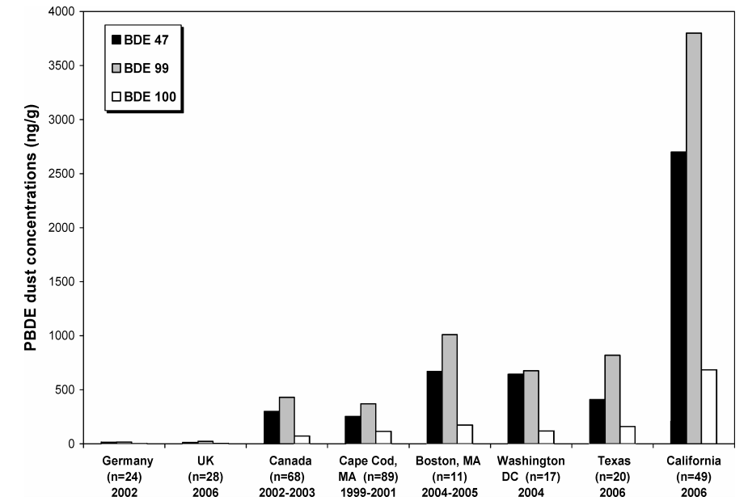
Notes:
Puzzle: California has much higher levels of flame retardants than other countries/places in the US. Why is this? Are these chemicals in dust getting into people’s bodies? NHANES can help us figure it out. More on this later.

Slide 4
Outline
Overview of NHANES
Where to find it
Nitty-gritty data details
Analyses

Slide 5
Outline
Overview of NHANES
Where to find it
Nitty-gritty data details
Analyses

Slide 6
What is NHANES?
National
Health
Nutrition
Examination
Survey
Modern NHANES: two year cycles, 1999-2016
Notes:
National: attempts to be nationally representative
Health: health measures
Nutrition: what people are eating
Examination: physical examination
Survey: combination of exams, laboratory testing, and surveys
Every two years

Slide 7
Demographics
Gender, age, race, education, income, …
Dietary
24 hour diet recalls, supplement use
Examination
Blood pressure, oral health, body measures
Laboratory
Chemicals in blood, urine; cholesterol; heavy metals
Questionnaire
Behaviors: alcohol, drug use; physical activity; food security

Slide 8
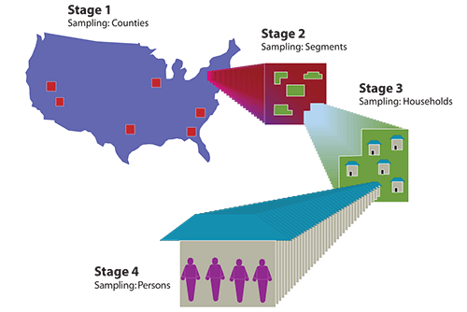
http://www.cdc.gov/nchs/images/nhanes/Stages.png

Slide 9
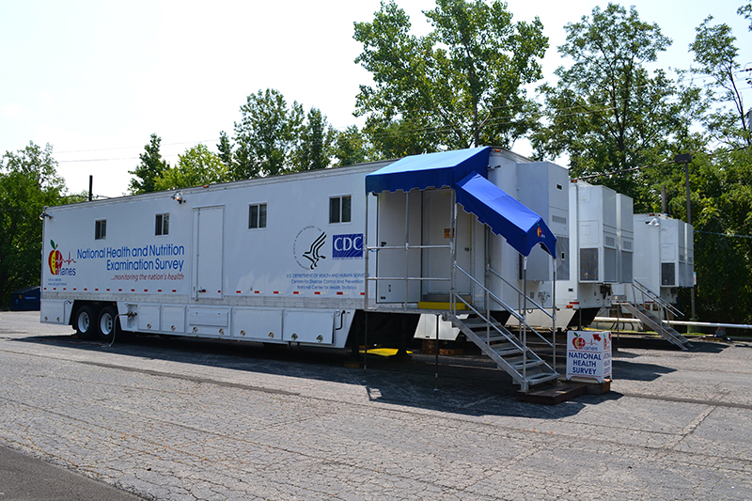

Slide 10
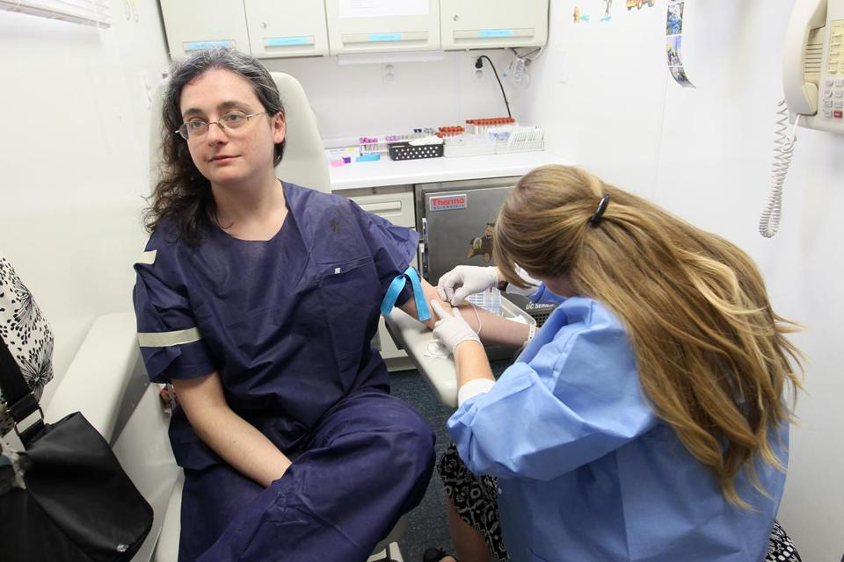

Slide 11
Outline
Overview of NHANES
Where to find it
Nitty-gritty data details
Analyzing NHANES in R

Slide 12
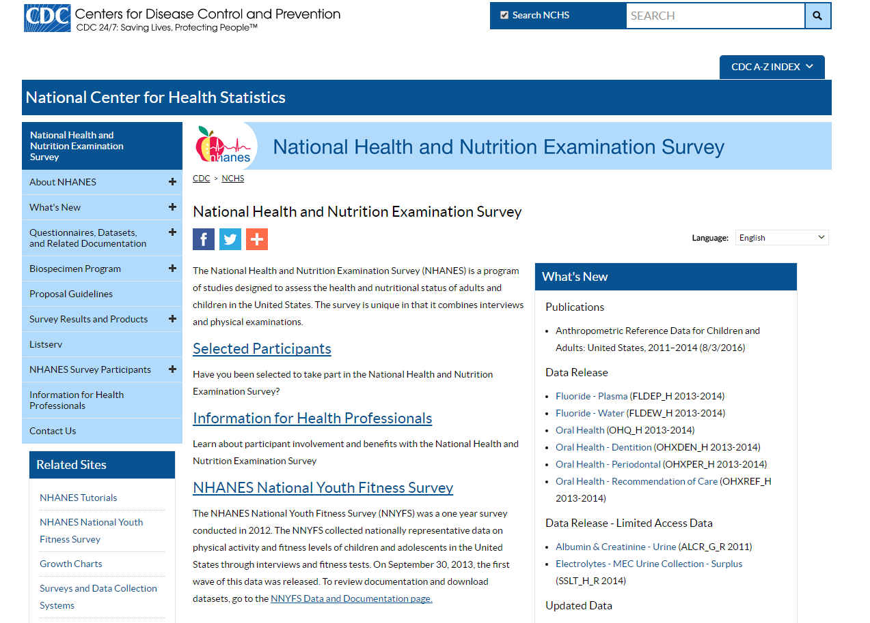
cdc.gov/nchs/nhanes

Slide 13
Outline
Overview of NHANES
Where to find it
Nitty-gritty data details
Analyses

Slide 14
Oversampling
Some demographic groups are oversampled
Adjusted for through sample weights
Notes:
Small populations wouldn’t get a large enough sample if the sample was chosen randomly. Instead, these populations are purposely oversampled, and then weighted down through sample weights.

Slide 15
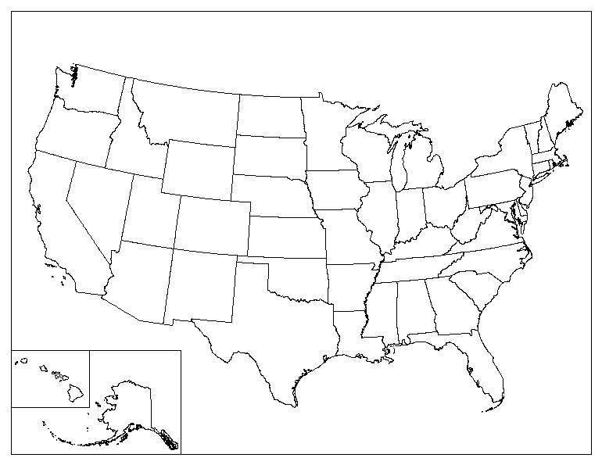
5,000 * 0.1% = 5
Notes:
Let’s look at an arbitrary made-up example to illustrate oversampling.
Suppose CDC is interested in people that own a parrot.
Let’s suppose that 0.1% of people in the US own a parrot.
If we just randomly chose people, then we would only get about 5 parrot owners if we sample 5,000 people.
Now, 5 is a pretty small sample size. We couldn’t be very confident in our estimates on parrot owners with only 5 people.
So to fix this we _artificially_ increase the number of parrot owners we sample, from say 5 to 50.
Now we have enough parrot owners to feel more confident in our statistics about this group.
The problem is, we’re not doing a random sample anymore, so our total estimates won’t be nationally representative.
However, we can fix this by using sample weights!
Here’s how it works: we assign a weight to every person that defines how “important” they are. These are taken into account when computing statistics on the whole group.
The oversampled groups, like parrot owners, are given lower weights, so that each individual isn’t as important (because they were over-sampled.)

Slide 16
The bottom line:
Want to compute an average?
Usually: add up all the numbers and divide by how many.
Not that easy with a complex survey design with sample weights.

Slide 17
Analysis needs to include:
Clustering
Survey weights

Slide 18
SEQN: Every participant has a unique ID number that you can use to link their data across multiple files
SDMVPSU: “primary sampling unit” (cluster)
SDMVSTRA: “stratum” (sub-cluster)
WTMEC2YR: Examination weight
WTINT2YR: Interview weight

Slide 19
Pooling
Limits of Detection
Column: “LBXPFOS”
Comment column: “LBDPFOSL”

Slide 20
Subsamples: NHANES doesn’t have enough blood to test every participant for every analyte
WTSA2YR: Subsample A weight

Slide 21
Outline
Overview of NHANES
Where to find it
Nitty-gritty data details
Analyses

Slide 22
Analyzing NHANES in R
“survey” package (the hard way)
“RNHANES” package (the easy way)
Online data explorer (the easiest way)

Slide 23
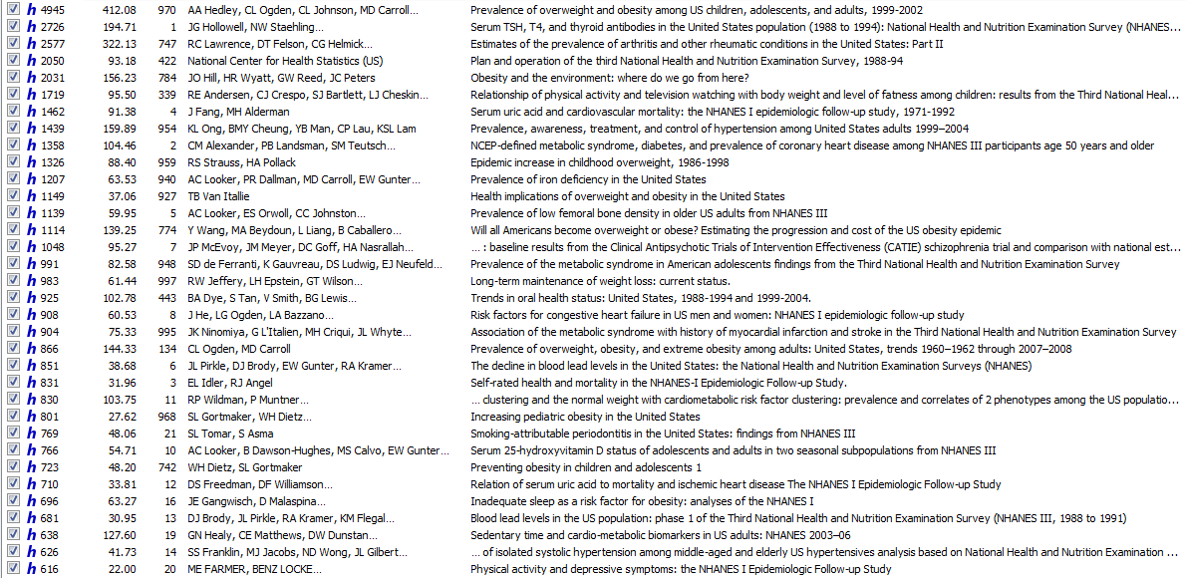

Slide 24
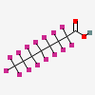
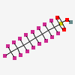
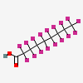
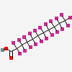
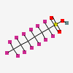
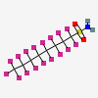
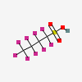
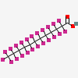
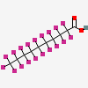
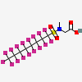
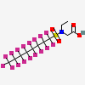
Motivating Example: PFCs

Slide 25
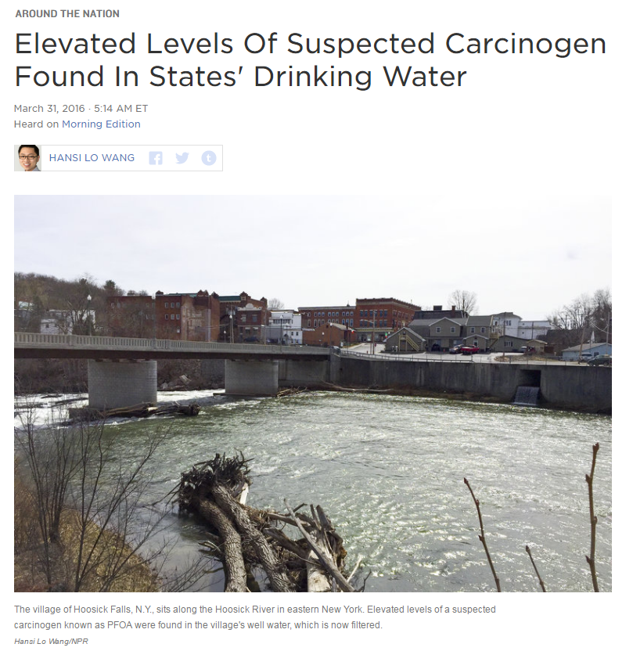
http://www.npr.org/2016/03/31/472501029/elevated-levels-of-suspected-carcinogen-found-in-states-drinking-water

Slide 26
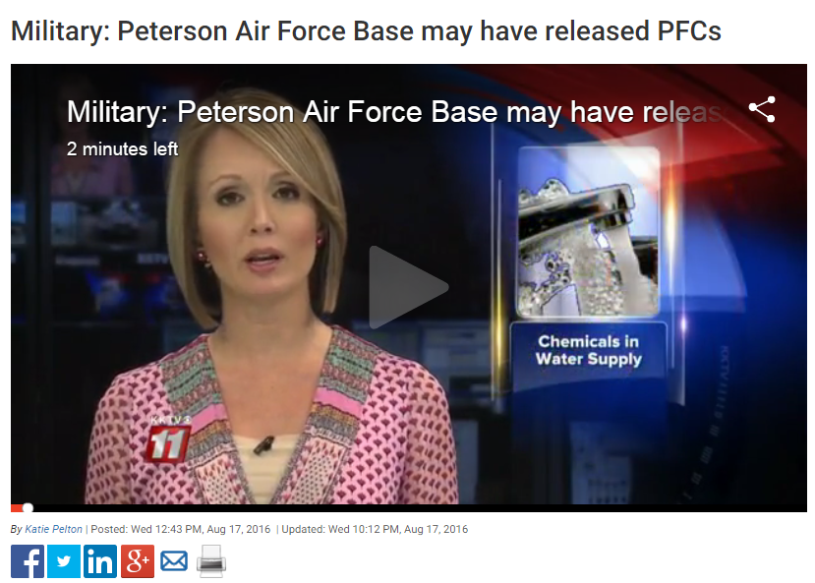
http://www.kktv.com/content/news/Military-Peterson-Air-Force-Base-may-have-released-PFCs-390469582.html

Slide 27
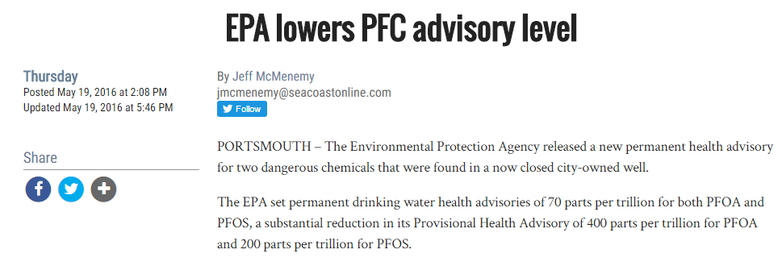
http://www.seacoastonline.com/article/20160519/NEWS/160518936

Slide 28
Exposure

Slide 29


Slide 30
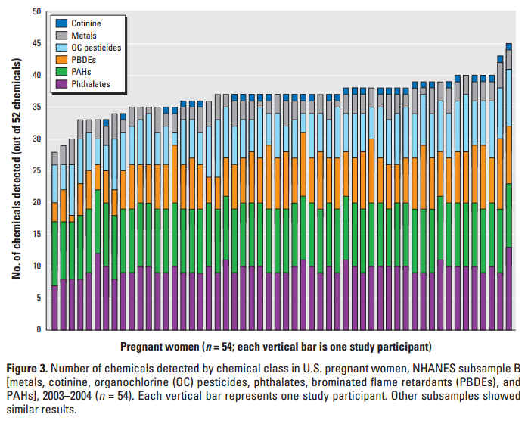
Woodruff, Tracey J., Ami R. Zota, and Jackie M. Schwartz. "Environmental chemicals in pregnant women in the United States: NHANES 2003-2004."Environmental health perspectives 119.6 (2011): 878.

Slide 31
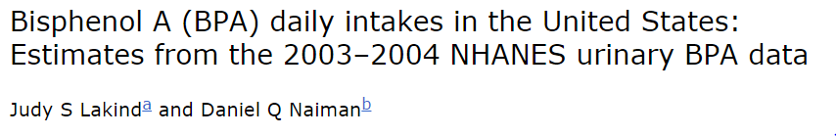
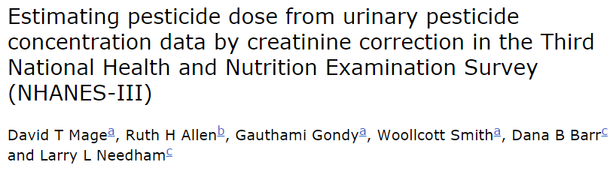

Slide 32
Regulatory efficacy

Slide 33
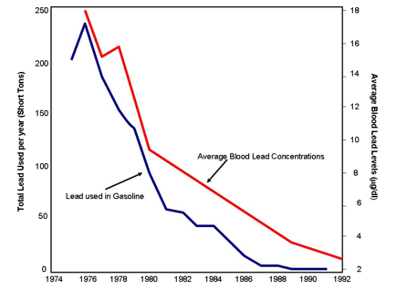
http://wiki.mnceh.org/images/a/ab/Lead1.png

Slide 34
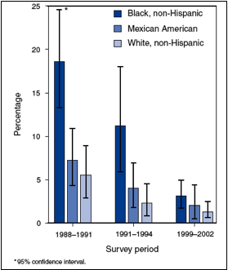
http://wiki.mnceh.org/images/e/e0/Lead2.png
Notes:
Figure 2. Percentage of children in three NHANES survey periods with blood lead levels greater than 10 µg/dl, by race/ethnicity (CDC 2005).
You can compare groups of people, and you can see how levels change over time.

Slide 35
Changes in exposure over time

Slide 36
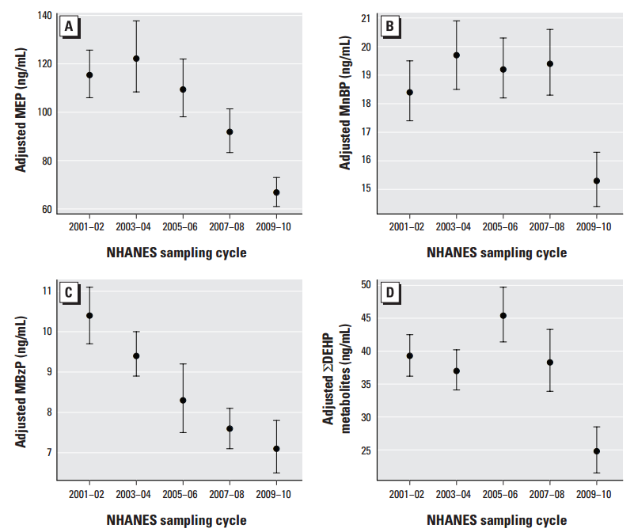
Zota, Ami R., Antonia M. Calafat, and Tracey J. Woodruff. "Temporal trends in phthalate exposures: findings from the national health and nutrition examination survey, 2001-2010." Environmental health perspectives 122.3 (2014).

Slide 37
Correlations

Slide 38
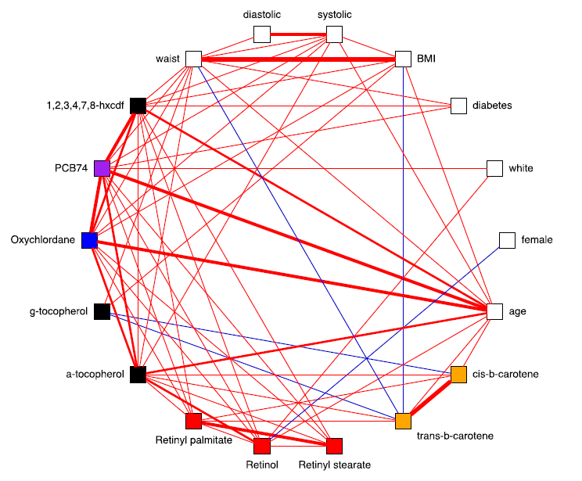
Patel, Chirag Jagdish, et al. Environment-wide Associations to Disease and Disease-related Phenotypes. Stanford University, 2011.

Slide 39
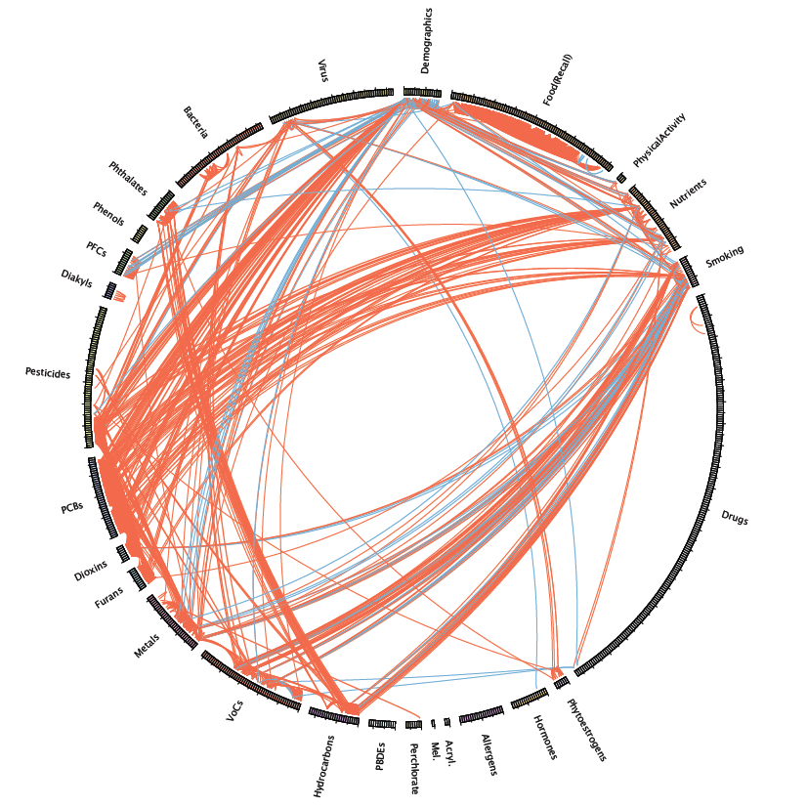
Patel, Chirag J., and Arjun K. Manrai. "Development of exposome correlation globes to map out environment-wide associations." Pacific Symposium on Biocomputing. Pacific Symposium on Biocomputing. Vol. 20. NIH Public Access, 2015.

Slide 40
Unintended side-effects of regulation

Slide 42
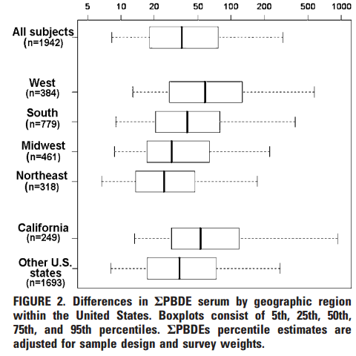
Zota, Ami R., et al. "Elevated house dust and serum concentrations of PBDEs in California: unintended consequences of furniture flammability standards?." Environmental science & technology 42.21 (2008): 8158-8164.

Slide 43
Dietary sources of exposure

Slide 44
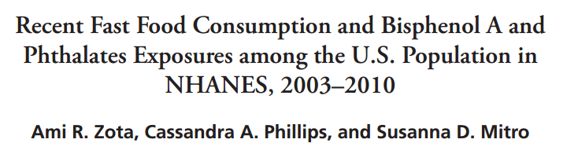

Slide 45
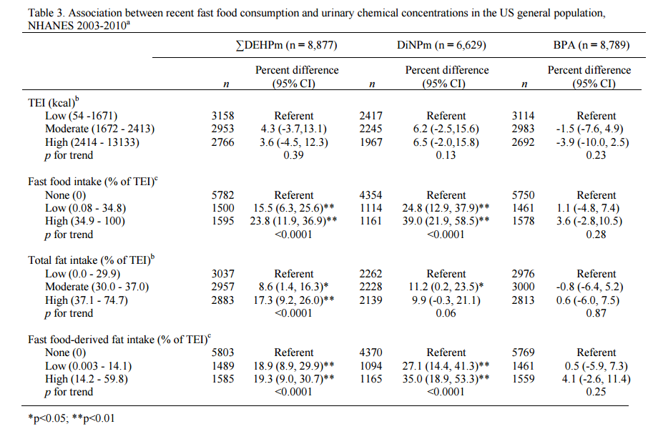
Zota, Ami R., Cassandra Phillips, and Susanna D. Mitro. "Recent fast food consumption and bisphenol A and phthalates exposures among the US population in NHANES, 2003-2010." Environmental health perspectives(2016).

Slide 46
NHANES as a comparison group case study: report-back
Notes:
http://45.33.82.210/

Slide 47
Outline
Overview of NHANES
Where to find it
Nitty-gritty data details
Analyses

Slide 48
Outline
Questions?

